Slide 1
Church
Living room
Restaurant
256x256 images synthesized by a Progressive GAN [Karras, et al 2017]
Notes:
These are all examples of images generated by a modern GAN trained, unsupervised, on three different sets of images.
As you can see, GANs are getting quite good at rendering such scenes. People will often confuse these generated images with original training set images.
Geeky information – images are all from LSUN. The dataset sizes are pretty big:
126,227 outdoor church images
1,315,802 living room images
626,331 restaurant images
Info for generating intervention examples - churchoutdoor images are seeded by 495,586,279,700

Slide 2
To render a beautiful scene, What does a GAN need to know?
Church
Notes:
One can imagine two general ways that a computer algorithm could generate a beautiful scene like this.
It could learn about objects and compose the scene out of objects it knows
Or it could memorize a scene that it saw in the training data and render one just like it
So… what do GANs know? Do they compose objects, or do they just memorize pure pixel patterns?

Slide 3
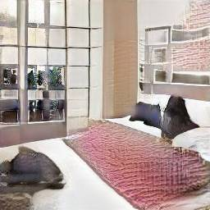
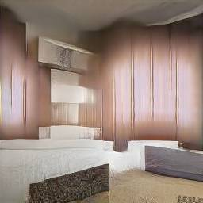
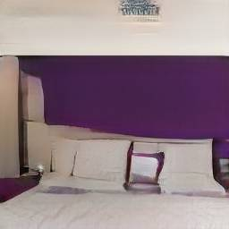
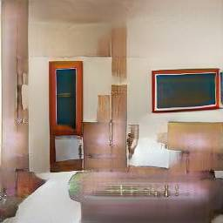
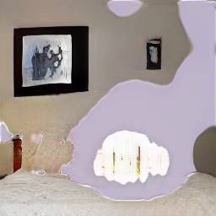
What causes the mistakes?
Bedroom
Notes:
We also want to know: what causes a GAN to make mistakes?
State-of-the-art GANs are still not perfect. They sometimes produce images that are quite unrealistic. Here is a progressive GAN trained on 3,033,042 bedroom images, the largest LSUN data set, and it still outputs images with visible artifacts, like the ones above. They appear about 5% of the time.
So we want to know: what causes these mistakes?

Slide 4




GAN Dissection: Visualizing and Understanding Generative Adversarial Networks
David Bau, Jun-Yan Zhu, Hendrik Strobelt, Bolei Zhou
Joshua B. Tenenbaum, William T. Freeman, Antonio Torralba
Notes:
These questions are the motivation behind the paper GAN Dissection.
The paper came from MIT and IBM (from our collaboration as the MIT-IBM Watson AI Lab).

Slide 5
Which units correlate to an object class?
Notes:
To understand the role of a neuron, we begin by asking about correlation.
We want to know “which convolutional units correlate to an object class that humans would recognize?”

Slide 6
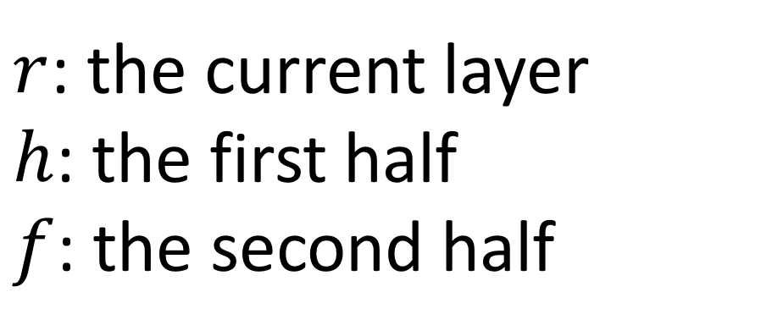
Which units correlate to an object class?
$r$: the current layer
$h$: the first half
$f$: the second half
Notes:
We start by sampling a bunch of random z, and running the generator.
Since we’re interested in the internal neurons, we split the generator at a specific layer, and examine the intermediate outputs of that layer.
The paper uses “r” to denote the representation (the intermediate output) of the layer of interest.

Slide 7
Which units correlate to an object class?
Notes:
Completing the generator will generate a synthetic image (a generated outdoor church is shown here).

Slide 8
Which units correlate to an object class?
Notes:
The representation r will contain the output of every neuron of a layer.
Since this is a fully convolutional net, the individual neurons of the layer are organized into convolutional channels, where each pixel of a channel behaves according to the same local rules as every other pixel in the channel. So to understand a neuron, we really want to understand a single convolutional channel.
We call a convolutional channel a “unit”. One unit of the representation forms a heat map over the image.

Slide 9
Which units correlate to an object class?
Notes:
To test correlations to human-understandable concepts, we use a pretrained segmentation network to label pixels in the generated image.
Here all the tree pixels are labeled.

Slide 10
Which units correlate to an object class?
Notes:
Then we ask “how well does a single representation unit solve the same problem as a segmentation network?”
To use a single unit to solve a segmentation, we just upsample the representation unit, and cuts the response at a fixed threshold.
(How to upsample? Just bilinear interpolation. Which threshold? It’s possible to do the analysis by just choosing a naïve fixed threshold such as the top 1%ile level for the unit, but the paper makes a slightly different choice that maximizes relative mutual information between the feature and the segmentation label being matched.)

Slide 11
Which units correlate to an object class?
Notes:
Then each unit is a little segmentation solution. A standard way to measure segmentation accuracy is IoU, so we use that to quantify how well the network is at solving each segmentation problem.
To be precise, we measure the IoU between the segmentation network (treating it as a ground truth) and the upsampled thresholded unit.
Examining every unit and every segmentation concept, we can identify units that seem to correlate with an object class. For example, this unit seems to indicate trees.

Slide 12
Which units correlate to an object class?
Church samples
Unit #119
Tree
Unit #32
Dome
Notes:
The IoU scores can be pretty good (e.g., > 0.3 for the best units), especially considering that the units emerge from a completely unsupervised training process.
This is pretty suggestive that the network is not just memorizing.
It suggests that the network is actually learning the structure of a scene and how it is made of different types of objects.

Slide 13
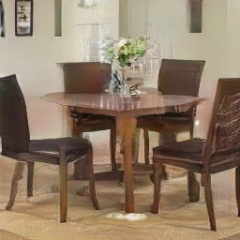
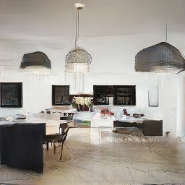
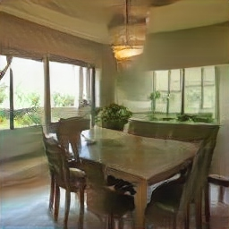
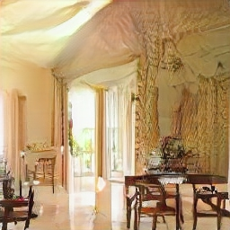
Which units correlate to an object class?
Dining room samples
Unit #139
Window
Unit #65
Table
Notes:
The effect doesn’t just occur for churches. Here are some examples from a dining room GAN. Tables, windows, chandeliers, etc – these all seem to be represented as distinct units.
On the other hand, it is not 1:1. There are a few dozen units that all correlate with dining room tables in this GAN.
This leads to the next question: since correlation is not the same as causation, can we tell what a neuron is really for?

Slide 14
Which units cause an object class?
Notes:
So we want to ask next, which neurons actually _cause_ a tree or a door or window.

Slide 15
Which units cause an object class?
Notes:
We can test this by choosing a set of units at a layer that we suspect are causal.
We will choose about 20 units that all correlate with the concept we want to test.

Slide 16
Which units cause an object class?
Notes:
Then we can test causality by forcing all 20 of those units off.
We literally reach into the network and just force the output of those neurons to zero, ignoring what they normally output, and then we continue the rest of the computation and generate the image.
We get a synthesized image like this.

Slide 17
Which units cause an object class?
Notes:
Then we analyze the synthesized image to see what object classes appear. Here we zeroed a bunch of units correlating with trees, and we can see, both qualitatively and according to the segmentation network, that there are fewer tree pixels in the output image.

Slide 18
Which units cause an object class?
Notes:
The second intervention we can do is that we can force those same units on.

Slide 19
Which units cause an object class?
Notes:
When we do that, in this case, trees now appear everywhere.

Slide 20
Which units cause an object class?
Notes:
The difference in the amount of trees in the output when our variables are forced on, and when they are forced off, is called the “Causal Effect.”
We can test this over a large sample of images and quantify the results as the “average causal effect”.
As a detail, we can also force a single neuron on and off (that is, just one pixel of the featuremap) and measure its local effects as well.

Slide 21
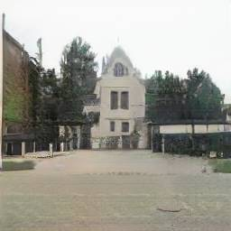
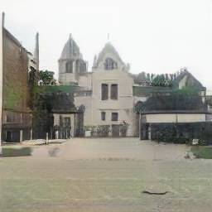
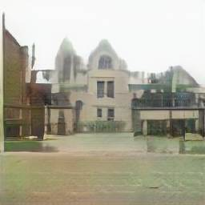
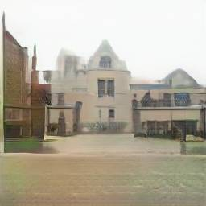
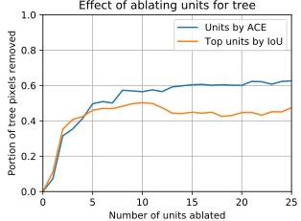
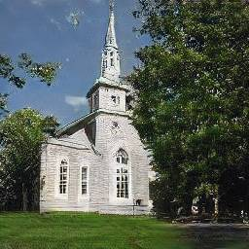
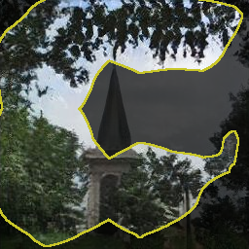
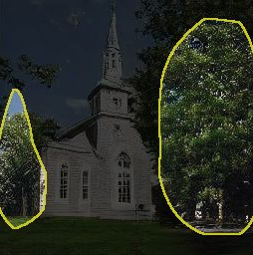

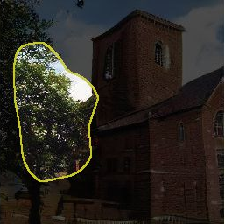
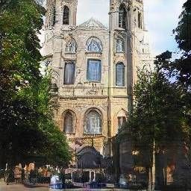
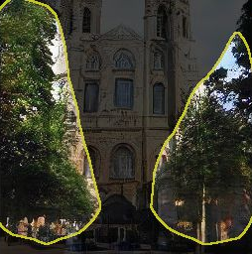

Removing or Adding Units
0
5
10
20
Number of tree units ablated
Notes:
Do neurons actually have causal effects?
Yes they do. The causal effects are stronger if you take sets of neurons together rather than individual ones. Here the causal effects are shown of zeroing 5, 10, and 20 units that are most highly correlated to trees. At the right the effects are quantified by average causal effect.
There are a couple ways we could choose the units to examine for causal effects. We could just look at the most correlated units (that’s the orange line). Or we could run an optimization to identify the units that are actually most causal (that’s the blue line). So if we’re being careful, we can notice that a few of the correlated units are not as important for causal effects as others, and the set of units can be chosen more carefully for stronger causal effects.

Slide 22
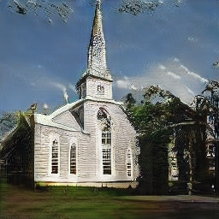
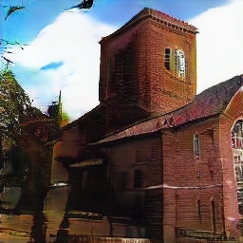
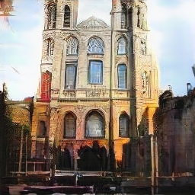
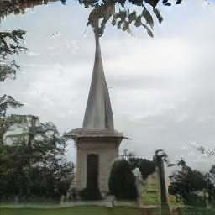
Removing or Adding Units
0
5
10
20
Number of tree units ablated
Notes:
The effects can be used to remove trees from images, as shown in these examples.

Slide 23
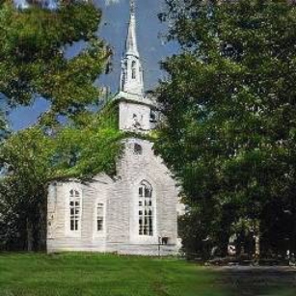
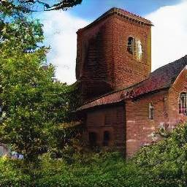
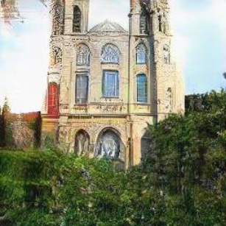

Removing or Adding Units
0
5
10
20
Number of tree units ablated
Notes:
The neurons can also be turned on to cause the effect of adding more trees to images, as shown in these examples.
In summary - these are the two methods the paper uses for understanding the individual neurons in a network.
Dissection, which looks for correlations between individual units and semantic concepts
Intervention, which measures the effect of turning on and off a group of units on the concepts in the output.

Slide 24
GAN Dissection: Comparing Datasets
Top objects: ceiling, wall, person, table…
Scene: conference room
Notes:
What can we find by dissection? The first thing we notice is that the neurons that emerge inside a GAN generator are pretty relevant to the scenes on which it was trained. For example, a conference room generator will have a neuron for conference tables, another for persons, another for seats.
Actually it will have several units for each of the above. So to visualize the distribution of such concept-correlated units, the paper shows several graphs. Here you can see many units for ceilings, walls, persons, tables, seats, floor, etc.

Slide 25
GAN Dissection: Comparing Datasets
Top objects: ceiling, window, chair, table…
Scene: dining room
Notes:
Switching the set of training images will result in neurons that learn different things. In a dining room, windows and chairs are more prominent.

Slide 26
GAN Dissection: Comparing Datasets
Notes:
In a kitchen, we see work surfaces (countertops) and stove-tops.
In outdoor churches we get things like grass, tree, domes, and doors.

Slide 27
GAN Dissection: Comparing Models
SWD (Sliced Wasserstein Distance) [Karras, et al 2017]: the lower, the better
Notes:
We can also use dissection to get some intuition about the effect of training a GAN with different training methods.
Here we examine a progressive GAN trained without two of the key tricks introduced by Karras. This GAN was trained without minibatch statistics and without pixewisel normalization. You can see qualitatively that the images don’t look that great. You can also see what concepts are learned by individual units.

Slide 28
GAN Dissection: Comparing Models
SWD (Sliced Wasserstein Distance) [Karras, et al 2017]: the lower, the better
Notes:
Karras introduced a training method they call “minibatch standard deviations” where the discriminator gets access to simple second-order statistics over the sample. The justification is to try to avoid mode collapse.
Using dissection we can see that the effect is pretty pronounced: lots more concepts emerge in individual units, and also more units overall are good matches for concepts.

Slide 29
GAN Dissection: Comparing Models
SWD (Sliced Wasserstein Distance) [Karras, et al 2017]: the lower, the better
Notes:
Then Karras improves stability by adding “pixelwise normalization”. This continues to increase the number of units that match concepts well.
Each of the measurements of SWD is a measure of how realistic the output distribution is (it’s a comparison of the distance between image statistics of the synthesized distribution and those of the true distribution, so lower is better). The better models also have more units that match semantics.
In other words, it seems that these methods for improving the output of a GAN also improve its ability to recognize and compose images out of objects!

Slide 30
GAN Dissection: Comparing Layers
Hard to find object concepts
Notes:
Where are the objects represented in a GAN? We can dissect different layers of a GAN and compare the results.
Interestingly, the output of the first convolutional layer of a GAN does not have object concepts in individual units.
That’s not to say the information about objects isn’t in there. By definition, everything output by the GAN is derived from the representation, so the object information must be inside there. However, it’s not clearly represented at this layer. There are very few individual units that correspond to object concepts (just a couple units that seem to correlate with ceilings).

Slide 31
GAN Dissection: Comparing Layers
Objects and object parts
Notes:
In contrast, as you move down to layer 4 and beyond, you get a significant number of units that correlate well with objects and object parts.

Slide 32
GAN Dissection: Comparing Layers
Texture, color, edges
Notes:
Going further down reveals units that are more correlated with textures, colors, and edges.
This is a similar picture to what has been seen before in classification convnets, but in reverse. As you get near the end of the network, you get closer to the pixels, and the convolution channels are dealing in pixel-related details.
Earlier in the network the units are more concerned about high-level concepts. Interestingly, if you go back too early, the concepts vanish again.

Slide 33
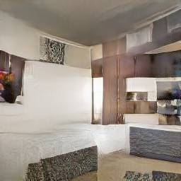

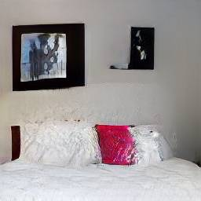
Debugging and Improving GANs
Unit #63
Bedroom images with artifacts
Unit #231
Example artifact-causing units
Ablating “artifact” units improves results
Notes:
Can any benefits come of the study of individual units?
Yes! We apply the idea towards debugging GANs. By examining the top-activating regions of units, we noticed that some units consistency activate on these buggy “artifact” image regions that are output occasionally.
Then interestingly, if you zero the top 20 such units and examine the modified output, the image quality improves! Here are a couple examples.
We have verified this improvement in a number of ways such as using FID and by polling AMT workers.
In the main paper the 20 artifact-causing units were found manually, but in the supplement we also describe a way to identify artifact-causing units by evaluating FID directly in a per-unit fashion by looking at a skewed distribution of generated images on which each individual unit fires the strongest.

Slide 34
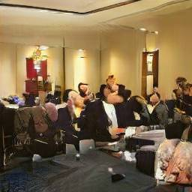

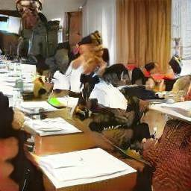
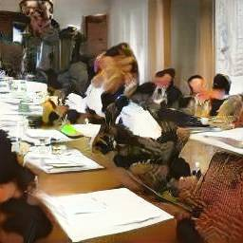
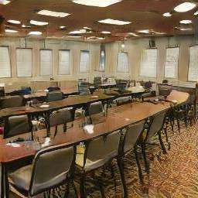


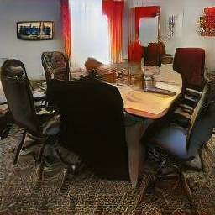
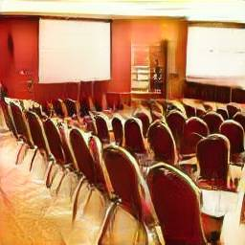
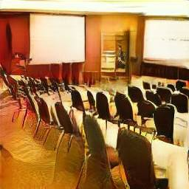
Object-Scene Relationship
ablate person units
ablate curtain units
ablate window units
ablate table units
ablate chair units
Notes:
Other things can also be removed from images, not just buggy artifacts.
For example, here we show the removal of various objects from conference rooms: people, curtains, windows, tables and chairs.
Each of the causal effects can be measured, and actually, we find that tables and chairs cannot be removed very easily from conference rooms. The measure of average causal effects is the portion of object pixels that are removed when 20 neurons are turned off.
So the interventions are providing some information about the structure of the model that the GAN has learned. It knows that people and windows and curtains are optional. But somehow, in a conference room, tables and chairs are less optional.

Slide 35


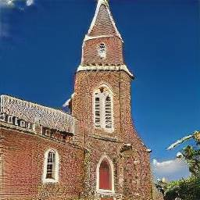
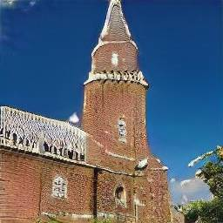
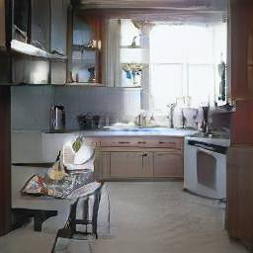
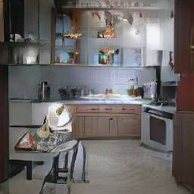
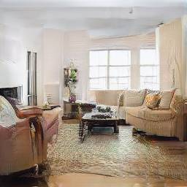
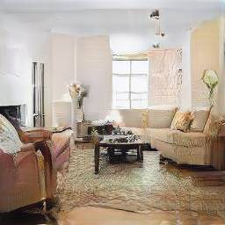
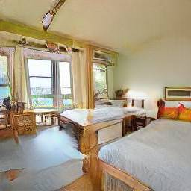
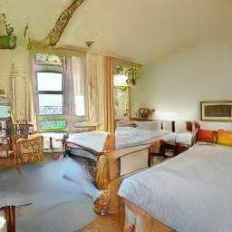
Object-Scene Relationship
conference room
church
kitchen
living room
bedroom
Notes:
Does the optionality of windows have to do with the pixels or the context? Looking at removal of windows in a bunch of different scene types, it appears that it has to do with the context. That is, windows are easy to remove from conference rooms, kitchens, and churches, but hard to remove from bedrooms or living rooms.
It seems that within a model of living rooms and bedrooms, windows are not very optional.
Did you know that modern building codes require bedrooms to have a window for fire safety reasons?
Somehow the GAN seems to have caught on to that pattern.

Slide 36
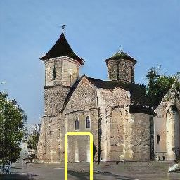
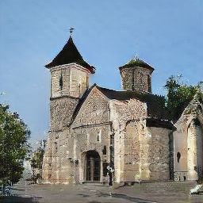
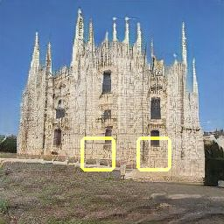
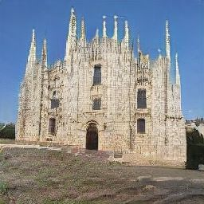
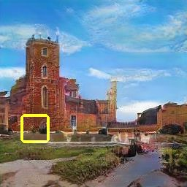





Object-Scene Relationship
Yellow bounding box: highlight every location where we can insert doors.
Notes:
Objects can also be inserted by activating neurons.
In this experiment, 20 door neurons are identified and activated. The exact same activation levels are used for a variety of featuremap pixels.
Those pixels where the intervention actually works are highlighted in yellow, and the results from an intervention are shown to the right.
Notice that even though the activation is the same in each case, the doors that are output look very different, and are sensitive to context, with different sizes, shapes, colors, and materials.
The other interesting thing is that calling for a door in the wrong location will result in very little changes in the image. The graph shows that while you can insert a door in a brick wall in a building, or in the location where many windows are, you can’t insert a door in the sky.

Slide 37

Paint with GANs
Notes:
To get a feel for such context effects, we implemented an interactive paint program that allows interventions anywhere in an image.
GAN Paint lets you turn on and off neurons that cause some common objects.
For example, you can use it to add a door to a church, or some trees next to a church, or add some domes.

Slide 38

Paint with GANs
Notes:
The buttons on the left each refer to the same 20 units regardless of the image.
Nevertheless, the same units can be used to apply edits to very different images.

Slide 39

Paint with GANs
Notes:
Notice that this is not like an ordinary paint program. It does not always do what you want - it wants objects to go in the right place.
You can use it to see how the model does not want to let doors appear in the sky.

Slide 40

Online Demo
http://bit.ly/ganpaint
Notes:
Here is the URL for GAN Paint. It works on a mobile phone – give it a try.

